Slide 1

INTERNET OF THINGS & DATA SCIENCE
Global Climate Data
IoT Platform
Forecasting Daily Temperature Using Machine Learning
Students
Course & Instructor
Live Demo
251023227 - Khud Bakhtiyar Iqbal Sofi
Course: Internet of Things and Applied Data Science
weather-iot.duckdns.org
251023202 - Mazen Ibrahim Awad Abdelhamid
24/7 Cloud Access
Instructor: Dr. Mehmet Ali Akyol
251023217 - Abdulrahman Ahmed Mubarak Bakouban
December 2025
1M+ Records Processed
Live-data processed
MAE: 1.82°C

Slide 2
The Challenge
Problem Statement
Core Problem
Why Does This Matter?
How can we accurately predict tomorrow's temperature? This is the fundamental challenge we're addressing with our IoT analytics platform.
Energy Planning
Agriculture
We're treating a public Kaggle dataset as virtual IoT sensors from 1000+ cities, creating an end-to-end IoT system architecture.
Forecast demand for heating/cooling systems to optimize resource allocation.
Enable farmers to plan irrigation schedules and crop management strategies.
Climate Risk
Public Health
Dataset Characteristics
Help utilities and governments prepare for extreme weather events.
Support comfort analytics and health risk assessments for communities.
1000+ global cities
10+ years historical data
1M+ weather records
Multiple features: temp, humidity, pressure, wind
Success Metrics
<5% missing values (interpolated)
≤ 2.0°C
≤ 2.5°C
≥ 0.85
Mean Absolute Error
Root Mean Square Error
R² Score

Slide 3
End-to-End Pipeline
System Architecture
Our complete IoT pipeline mirrors real-world systems: sensors → ingestion → storage → processing → visualization → cloud. This six-layer architecture demonstrates production-grade IoT analytics.
1
2
3
4
5
6
Data Source
ETL Pipeline
Database
ML Models
Dashboard
Cloud Deploy
Kaggle CSV Dataset
Pandas / NumPy
PostgreSQL
ARIMA / Prophet
Streamlit App
AWS EC2 Free Tier
1M+ Records
Clean & Filter
TimescaleDB
MAE: 1.82°C
4 Interactive Tabs
Nginx Proxy
1000+ Cities
Outlier Removal
Time-Series Optimized
R²: 0.87
Global Heatmap
DuckDNS Domain
10+ Years Data
Missing Values
Reliable Storage
Model Comparison
Real-time Metrics
24/7 Uptime
Data Quality
Time-Series DB
Production Ready
Comprehensive ETL pipeline handles missing values through linear interpolation and removes outliers using IQR method.
TimescaleDB extension optimizes PostgreSQL for time-series data, delivering 10x better performance than standard relational databases.
Nginx reverse proxy and systemd service ensure 24/7 uptime with automatic restart capabilities.

Slide 4
Results & Analysis
Data Characteristics & Model Performance
Dataset Overview
Model Comparison Results
Dataset Name
Model | MAE | RMSE | R² | Status
ARIMA | 1.82°C | 2.34°C | 0.8734 | BEST
Prophet | 1.95°C | 2.41°C | 0.8621 | 2nd
XGBoost | 2.05°C | 2.48°C | 0.8515 | 3rd
Target | ≤ 2.0°C | ≤ 2.5°C | ≥ 0.85
The Weather Dataset (Kaggle)
1000+
10+
Global Cities
Years Daily Data
1M+ observations with multiple features: temperature, humidity, pressure, wind speed, precipitation.
Data Quality Handling
Target Exceeded
Variance Explained
Missing Values
Outlier Removal
ARIMA achieves 1.82°C MAE, exceeding the 2°C target.
R² of 0.87 means the model explains 87% of temperature variance.
Less than 5% missing data handled via linear interpolation
IQR method to detect and remove anomalous temperature readings

Slide 5
Live Demo Available
Interactive Dashboard Walkthrough
weather-iot.duckdns.org
Tab 1: Overview
Tab 2: Trends
Tab 3: Forecasts
Tab 4: Analytics
Real-time metric cards showing current temp, min/max, humidity
Multi-city temperature line charts for comparison
30-day temperature forecast with ARIMA model
Temperature distribution histograms by city
Interactive global temperature heatmap with hover details
Humidity trends with moving averages (7/30/90 days)
95% confidence intervals showing prediction uncertainty
Anomaly detection using IQR method
Statistical summaries (mean, std, min, max)
Comprehensive city summary table with sortable columns
Correlation heatmaps between weather variables
Forecast accuracy metrics (MAE, RMSE on test set)
Seasonal pattern visualization across years
Use Case: Deep data exploration and anomaly detection
Use Case: Quick overview of current conditions worldwide
Use Case: Future temperature predictions for planning
Use Case: Historical analysis and trend identification
Sidebar Filters & Interactivity
City Selection
Date Range
Metric Selection
Forecast Horizon
Multi-select dropdown for comparing multiple cities
Interactive date picker for historical analysis
Switch between temperature, humidity, pressure
Adjustable from 7 to 90 days ahead

Slide 6
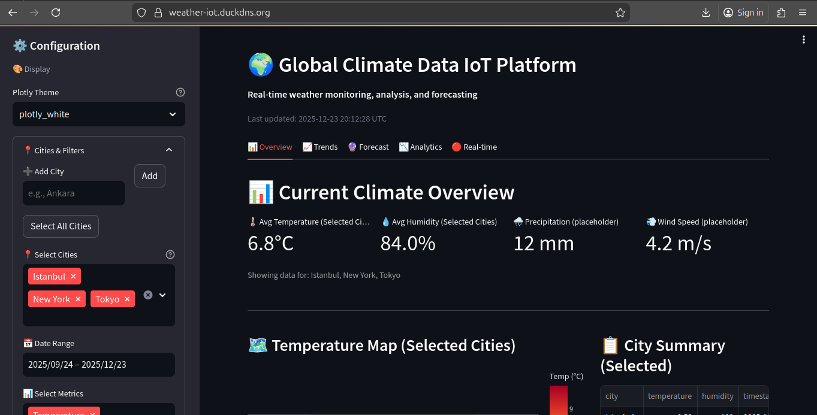

Slide 7
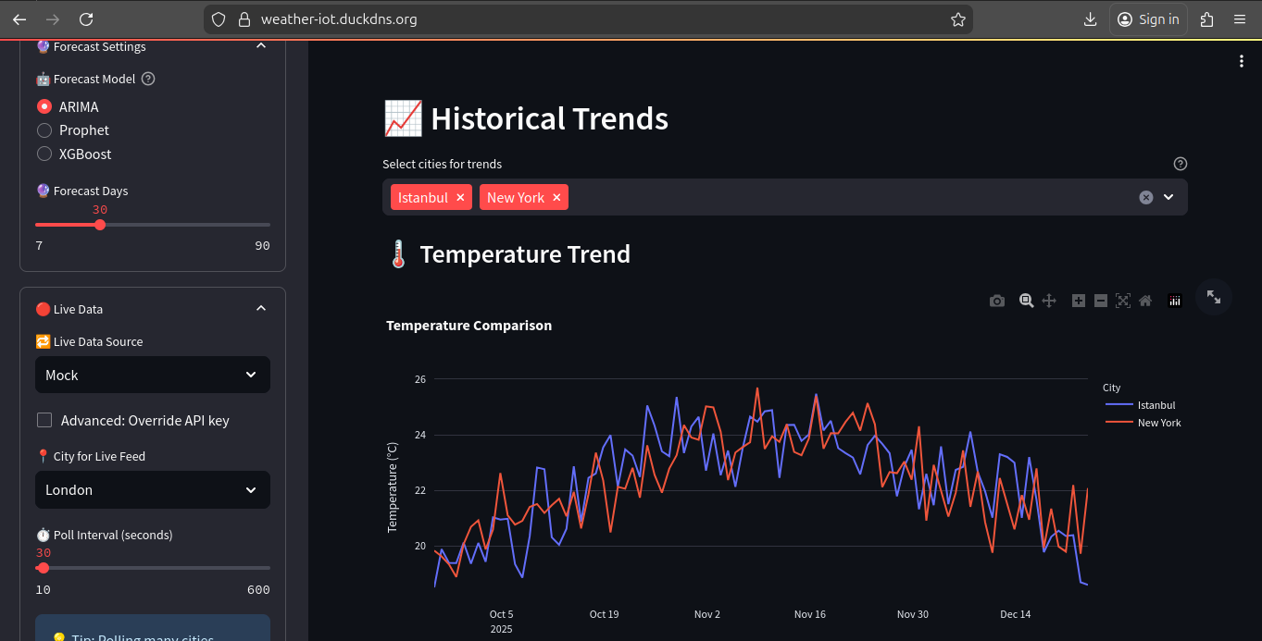

Slide 8
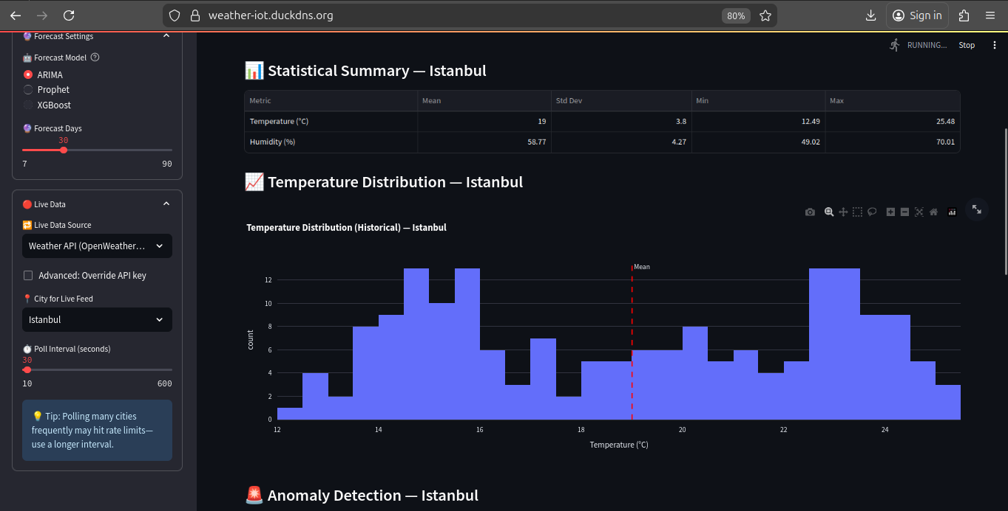

Slide 9
Production-Grade System
Cloud Deployment & Infrastructure
AWS EC2
Running Services
Domain & Access
Instance Type
t2.micro
PostgreSQL + TimescaleDB (5432)
Dynamic DNS
DuckDNS (Free)
OS
Ubuntu 22.04 LTS
Streamlit App (8501)
Custom Domain
Storage
8GB SSD
weather-iot.duckdns.org
RAM
1GB
Nginx Proxy (80/443)
Availability
24/7 Public Access
Cost
$0 (Free Tier)
Systemd Service (auto-restart)
SSL Certificate
Let's Encrypt (Free)
Production Architecture
Users
Nginx
Streamlit
PostgreSQL
Systemd
Global Access
Reverse Proxy
Dashboard App
Data Storage
Auto-Restart

Slide 10
Project Outcomes
Key Achievements & Learnings
Major Achievements
Key Learnings
1
Complete IoT Pipeline
Time-Series Databases
End-to-end system: Data → DB → Models → Dashboard → Cloud
TimescaleDB outperforms standard PostgreSQL for time-series data with 10x better query performance.
2
1M+ Records Processed
ARIMA Modeling
Successfully ingested and cleaned global climate data
Classical statistical methods still beat complex models for weather forecasting. ARIMA's interpretability is a key advantage.
3
3 ML Models Trained
ARIMA, Prophet, XGBoost with scientific comparison
Streamlit Framework
4
Model Performance
Enables rapid prototyping of data dashboards. From script to deployed app in hours, not weeks.
MAE: 1.82°C (exceeded 2°C target), R²: 0.87
5
Interactive Dashboard
Cloud Deployment
4 tabs, real-time metrics, forecasts with 95% CI
AWS Free Tier is sufficient for small-to-medium projects. Production-grade systems can be built at zero cost.
6
Cloud Deployment
AWS EC2 + DuckDNS domain, running 24/7
IoT Architecture Patterns
Production-Ready
Mirrors real systems: Tesla, NASA, utilities use the same architecture (sensors → database → AI → UI).
7
Nginx proxy, auto-restart, monitoring, error handling
Data Pipeline Importance
8
Full Documentation
Data cleaning and preprocessing takes 80% of development time; modeling only 20%. Quality data is everything.
README, setup guides, deployment docs, code comments

Slide 11
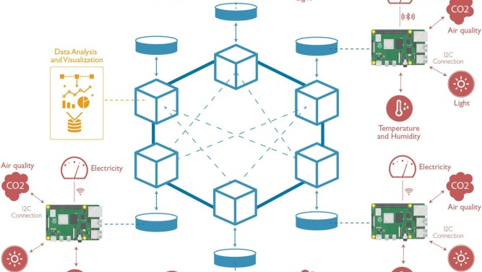
Project Summary
Conclusion & Future Work
Project Summary
Future Work
Project Artifacts
Problem
Real IoT Sensors: Replace Kaggle data with ESP32 sensors for true IoT implementation
Predict temperature accurately for global cities
GitHub Repository
github.com/kbakhtiyaris/climate-iot-project
Deep Learning: Add LSTM/Transformer models for longer-horizon forecasts
Khudbakhtiyariqbalsofi.vercel.app
Solution
8+ Python modules
Streamlit dashboard
End-to-end IoT platform with ML forecasting
ML training scripts
Full documentation
Authentication: Implement user accounts and alert notifications
Result
1.82°C MAE (exceeds 2°C target)
Mobile App: Develop iOS/Android apps for mobile access
Available Resources
README with setup instructions
Users
API Integration: Connect with OpenWeatherMap for real-time data
Deployment guides
weather-iot.duckdns.org
Demo videos
Questions & Discussion
Thank You!
I'm happy to discuss: Architecture decisions • Model tuning • Deployment challenges • Data pipeline design • Cloud optimization
kbakhtiyaris
mazenibrahem2001-cloud
CodeBreaker-03

